Slide 1
Red-black trees
Mahdi Ebrahimi

Slide 2
Outline
In this topic, we will cover:
The idea behind a red-black tree
Defining balance
Insertions
The benefits of red-black trees over AVL trees

Slide 3
Balanced search trees
Balanced search tree: A search-tree data structure for which a height of O(lg n) is guaranteed when implementing a dynamic set of n items.
Examples:
AVL trees
Red-black trees
2-3 trees
2-3-4 trees
B-trees/B⁺-trees
October 19, 2005
Copyright © 2001-5 by Erik D. Demaine and Charles E. Leiserson
L7.2

Slide 4
Red-black trees
This data structure requires an extra one-bit color field in each node.
Red-black properties:
Every node is either red or black.
The root and leaves (NIL’s) are black.
If a node is red, then its parent is black.
All simple paths from any node x to a descendant leaf have the same number of black nodes = black-height(x).
October 19, 2005
Copyright © 2001-5 by Erik D. Demaine and Charles E. Leiserson
L7.3

Slide 5
Red Black Trees
A BST with more complex algorithms to ensure balance
Each node is labeled as Red or Black.
Path: A unique series of links (edges) traverses from the root to each node.
The number of edges (links) that must be followed is the path length
In Red Black trees paths from the root to elements with 0 or 1 child are of particular interest

Slide 6
Red-Black Trees
A red black tree “colours” each node within a tree either red or black
This can be represented by a single bit
In AVL trees, balancing restricts the difference in heights to at most one
For red-black trees, we have a different set of rules related to the colours of the nodes

Slide 7
Red-Black Trees
A little manipulation shows that the worst-case height simplifies to
h_{worst} = 2 lg(n + 2) – 3
This grows quicker than the worst-case height for an AVL tree
h_{worst} = log_{φ}( n ) – 1.3277

Slide 8
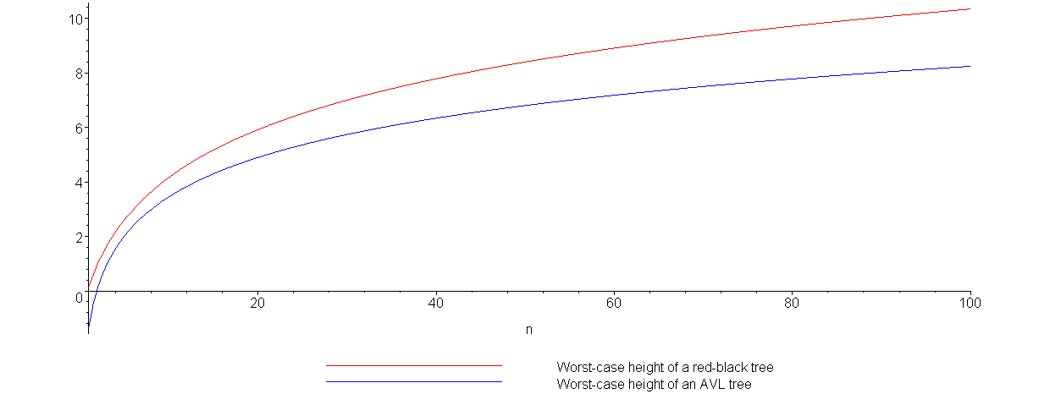
Red-Black Trees
Plotting the growth of the height of the worst-case red-black tree (red) versus the worst-case AVL tree (blue) demonstrates this:

Slide 9
Red-Black Trees
Height | AVL Tree | Red-Black Tree
1 | 2 | 2
3 | 7 | 6
5 | 20 | 14
7 | 54 | 30
9 | 143 | 62
11 | 376 | 126
13 | 986 | 254
15 | 2583 | 510
17 | 6764 | 1022
19 | 17710 | 2046
21 | 46367 | 4094
23 | 121492 | 8190
25 | 317810 | 16382
27 | 832039 | 32766
29 | 2178308 | 65534
31 | 5702886 | 131070
33 | 14930351 | 262142
This table shows the number of nodes in a worst-case trees for the given heights
Thus, an AVL tree with 131070 nodes has a height of 23 while a red-black tree could have a height as large as 31

Slide 10
Red-Black Trees
Comparing red-black trees with AVL trees, we note that:
Red-black trees require one extra bit per node
AVL trees require one byte per node (assuming the height will never exceed 255)
aside: we can reduce this to two bits, storing one of –1, 0, or 1 indicating that the node is left heavy, balanced, or right heavy, respectively

Slide 11
Red-Black Trees
AVL trees are not as deep in the worst case as are red-black trees
therefore AVL trees will perform better when numerous searches are being performed,
however, insertions and deletions will require:
more rotations with AVL trees, and
require recursions from and back to the root
thus AVL trees will perform worse in situations where there are numerous insertions and deletions

Slide 12
Insertions
We will consider two types of insertions:
bottom-up (insertion at the leaves), and
top-down (insertion at the root)
This part is optional, and you can study by yourself.
The first will be instructional and we will use it to derive the second case

Slide 13
Bottom-Up Insertions
After an insertion is performed, we must satisfy all the rules of a red-black tree:
1. The root must be black,
2. If a node is red, its children must be black, and
3. Each path from a node to any of its descendants which are is not a full node (i.e., two children) must have the same number of black nodes
The first and second rules are local: they affect a node and its neighbours
The third rule is global: adding a new black node anywhere will cause all of its ancestors to become unbalanced

Slide 14
Bottom-Up Insertions
Thus, when we add a new node, we will add a node so as to break the global rule:
the new node must be red
We will then travel up the tree to the root fixing the requirement that the children of a red node must be black

Slide 15
Bottom-Up Insertions
If the parent of the inserted node is already black, we are done
Otherwise, we must correct the problem
We will look at two cases:
the initial insertion, and
the recursive steps back to the root

Slide 16
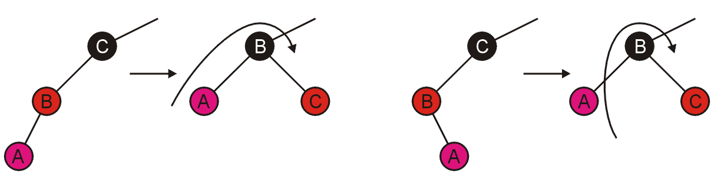
Bottom-Up Insertions
For the initial insertion, there are two possible cases:
the grandparent has one child (the parent), or
the grandparent has two children (both red)
Inserting A, the first case can be fixed with a rotation:
Consequently, we are finished...

Slide 17
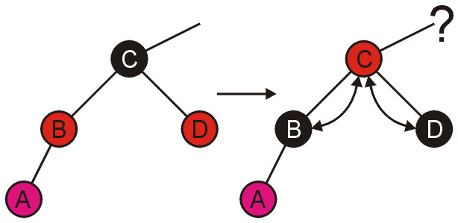
Bottom-Up Insertions
The second case can be fixed more easily, just swap the colours:
Unfortunately, we now may cause a problem between the parent and the grandparent....

Slide 18
Bottom-Up Insertions
Fortunately, dealing with problems caused within the tree are identical to the problems at the leaf nodes
Like before, there are two cases:
the grandparent has one child (the parent), or
the grandparent has two children (both red)

Slide 19
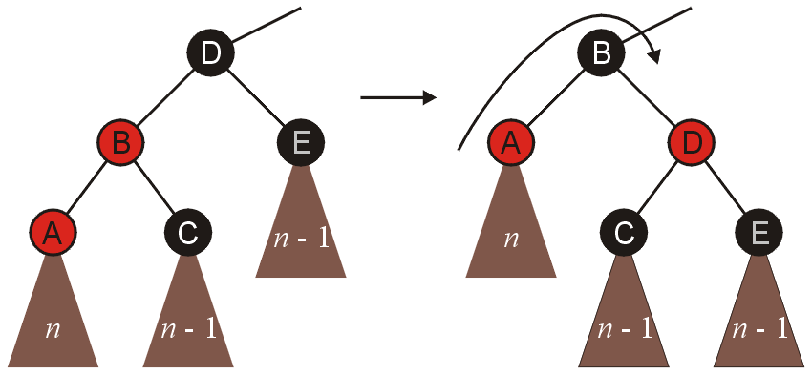
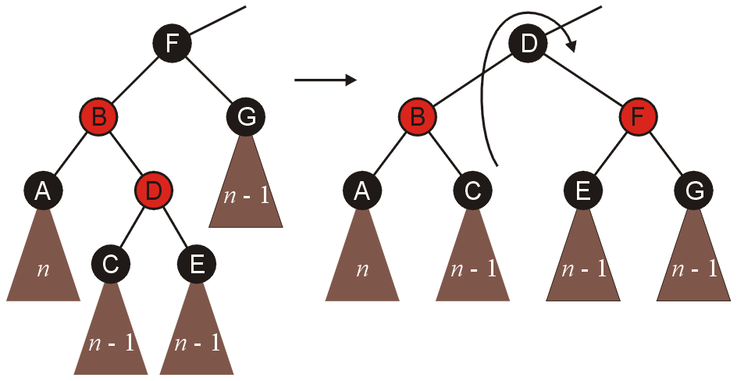
Bottom-Up Insertions
Suppose that A and D, respectively were swapped
In both these cases, we perform similar rotations as before, and we are finished

Slide 20
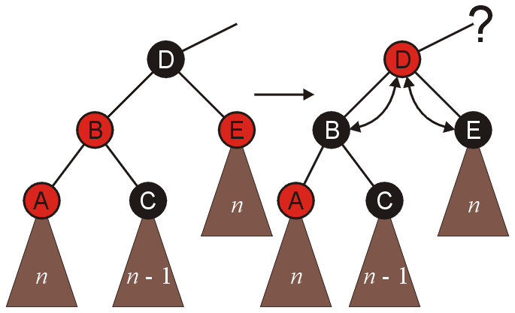
Bottom-Up Insertions
In the other case, where both children of the grandparent are red, we simply swap colours, and recurs back to the root

Slide 21
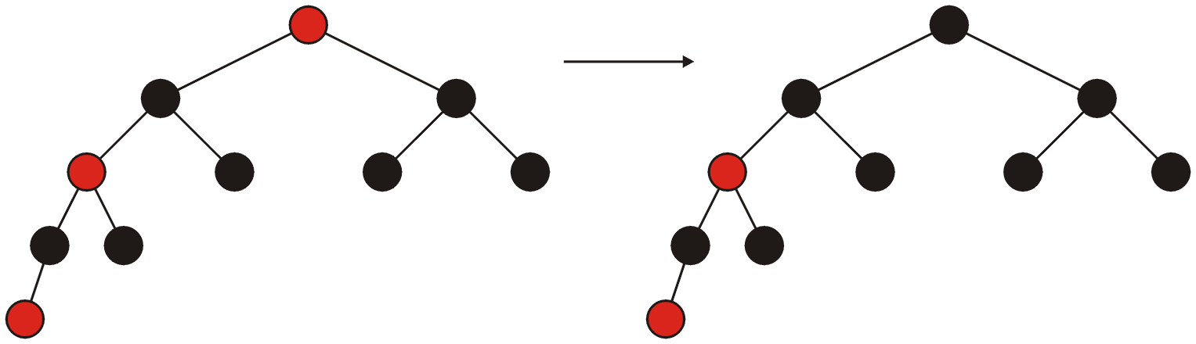
Bottom-Up Insertions
If, at the end, the root is red, it can be coloured black

Slide 22
Red Black Trees Insertion
Step 1 - If tree is Empty then insert the newNode as Root node with color Black and exit from the operation.
Step 2 - If tree is not Empty then insert the newNode as leaf node with color Red.
Step 3 - If the parent of newNode is Black then exit from the operation.
Step 4 - If the parent of newNode is Red then check the color of parentnode's sibling of newNode (Uncle’s newNode).
Step 4.a - If it is colored Black or NULL then make suitable rotation and recolor.
Step 4.b - If it is colored Red then perform recolor and also check if parent’s parent of newNode (grandparent’s newNode) is not root node then recolor it and recheck (repeat the same until tree becomes Red Black Tree.)

Slide 23
We have 3 cases for insertion
Case 1: Recolor (uncle is red)
G
G
P
U
P
U

Slide 24
Case 2:
Double Rotate: X around P then X around G.
Recolor G and X
G
X
P
P
U
G
X
S
U
S

Slide 25
Case 3:
Single Rotate P around G
Recolor P and G
G
P
P
U
X
G
S
X
S
U

Slide 26
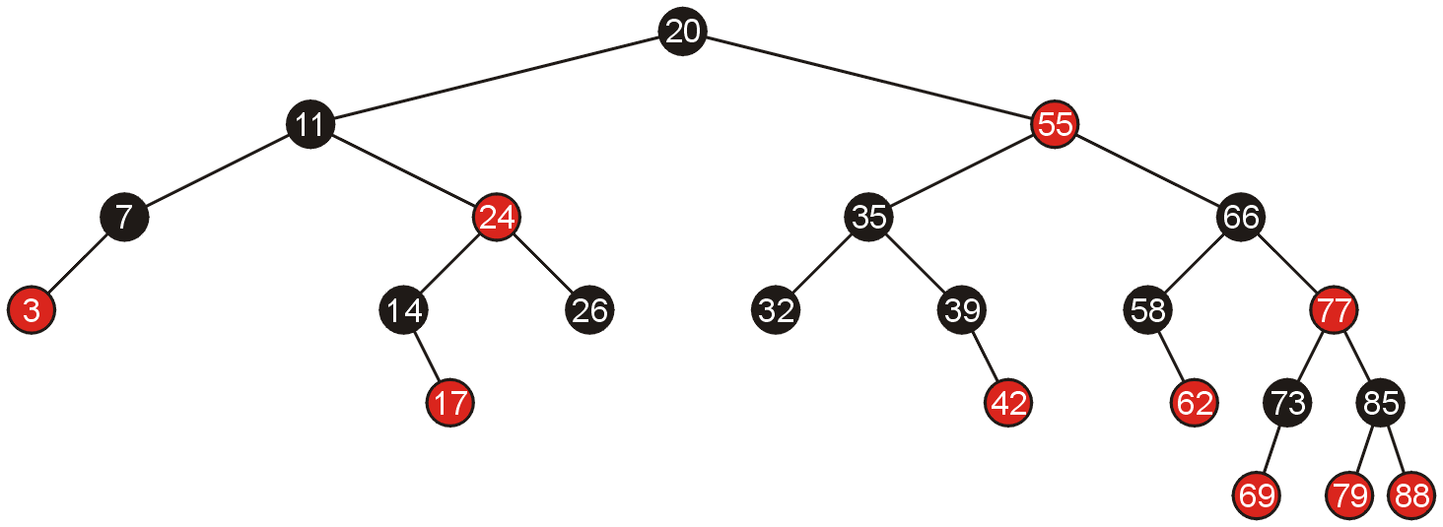
Examples of Insertions
Given the following red-black tree, we will make a number of insertions

Slide 27
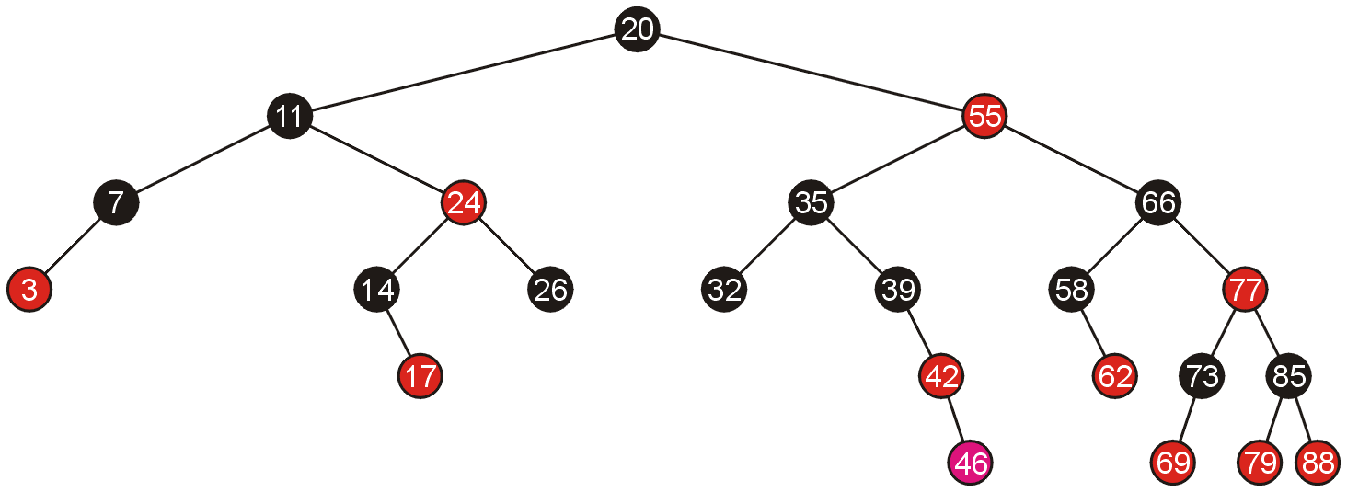
Examples of Insertions
Adding 46 creates a red-red pair which can be corrected with a single rotation

Slide 28
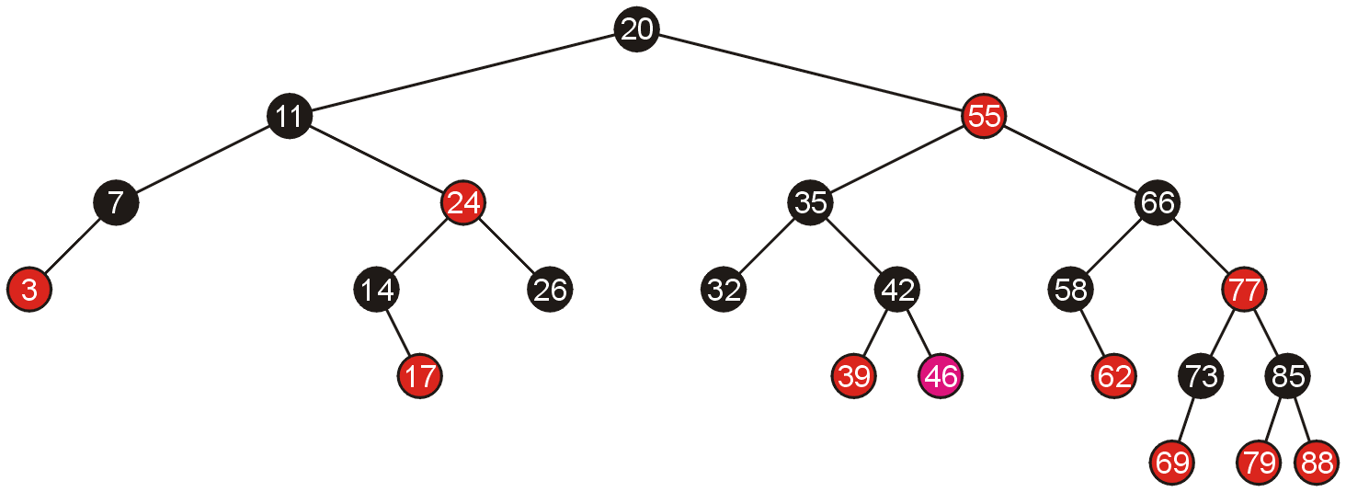
Examples of Insertions
Because the pivot is still black, we are finished

Slide 29
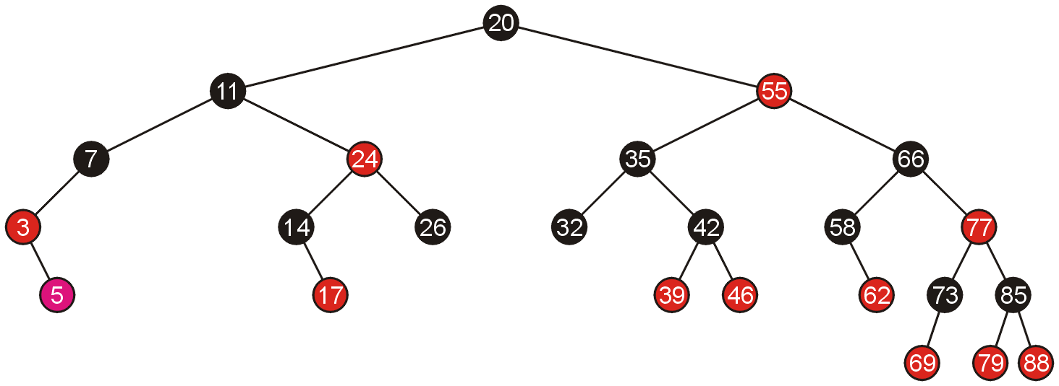
Examples of Insertions
Similarly, adding 5 requires a single rotation

Slide 30
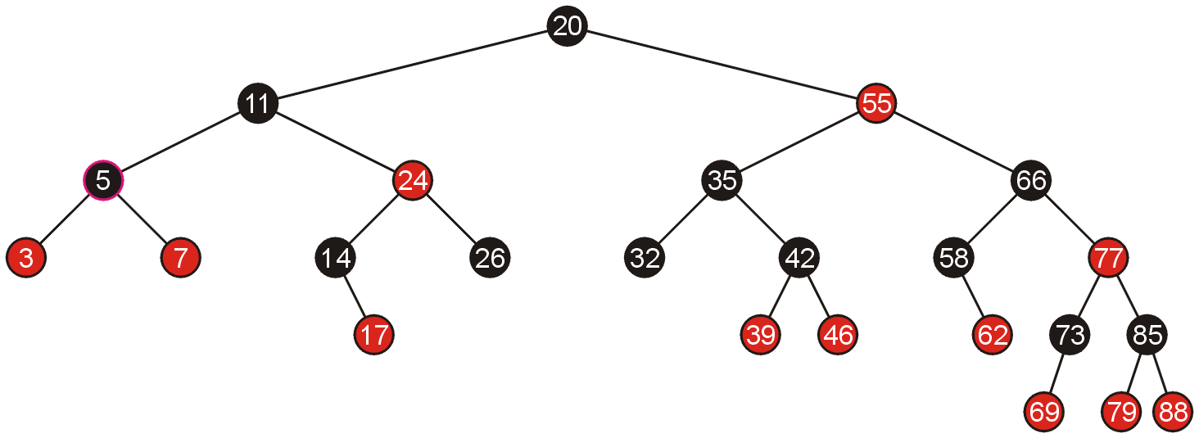
Examples of Insertions
Which again, does not require any additional work

Slide 31
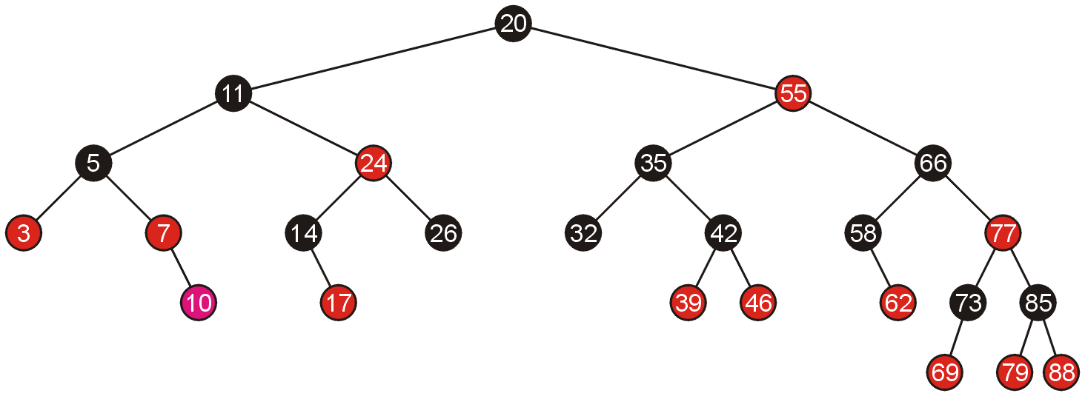
Examples of Insertions
Adding 10 allows us to simply swap the colour of the grand parent and the parent and the parent’s sibling

Slide 32
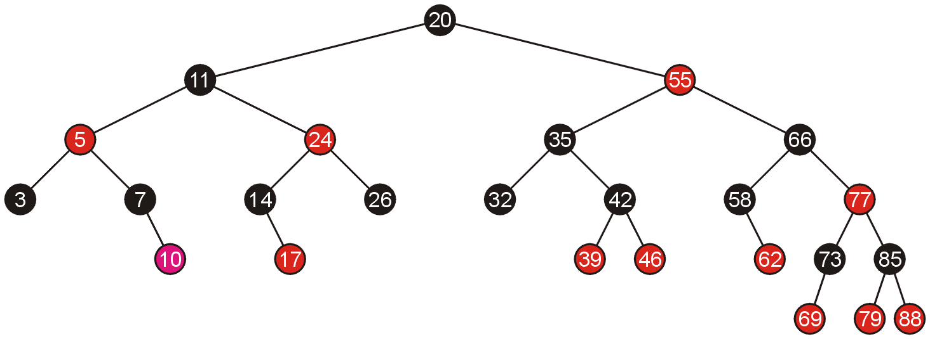
Examples of Insertions
Because the parent of 5 is black, we are finished

Slide 33
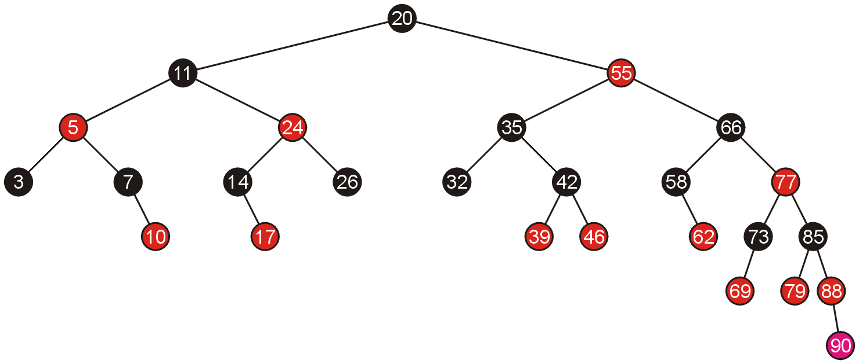
Examples of Insertions
Adding 90 again requires us to swap the colours of the grandparent and its two children

Slide 34
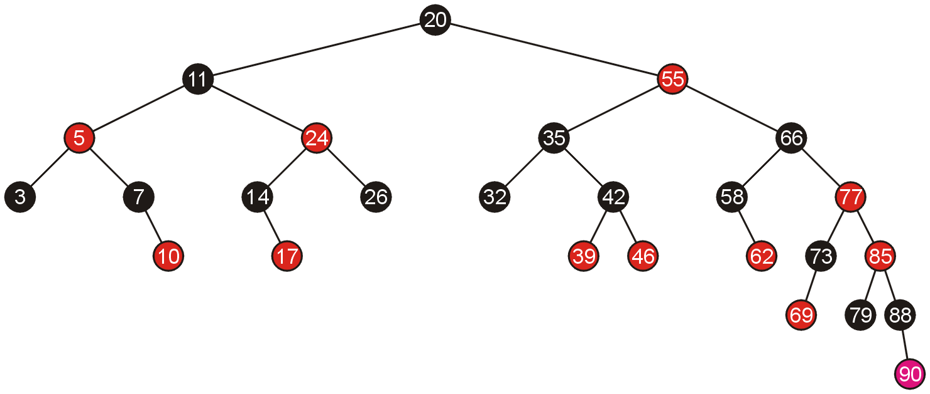
Examples of Insertions
This causes a red-red parent-child pair, which now requires a rotation

Slide 35
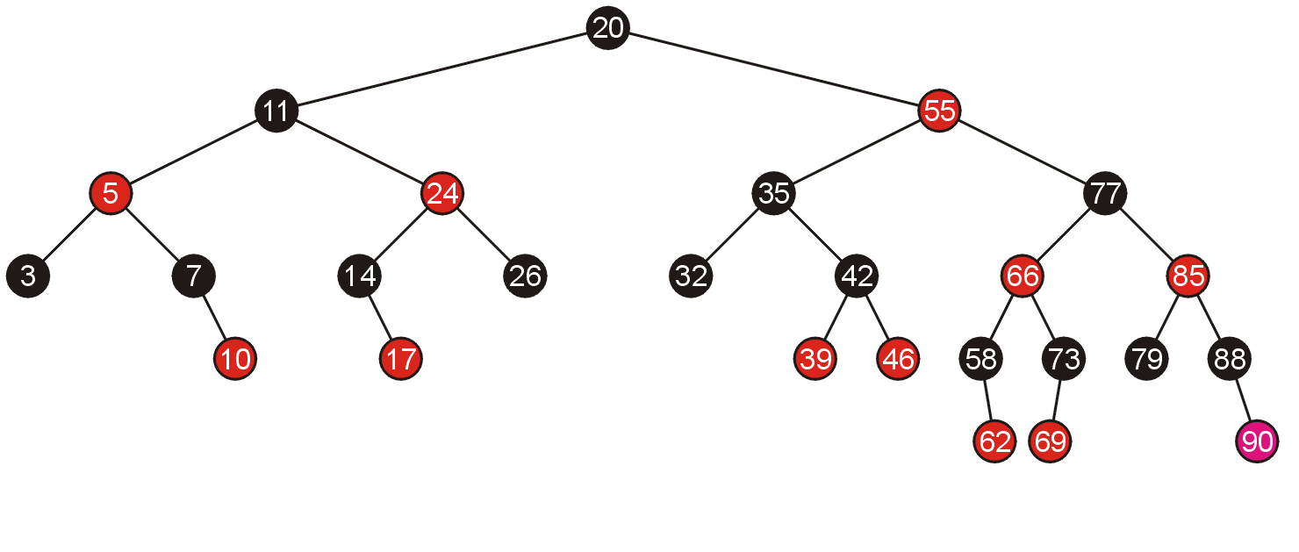
Examples of Insertions
A rotation does not require any subsequent modifications, so we are finished

Slide 36
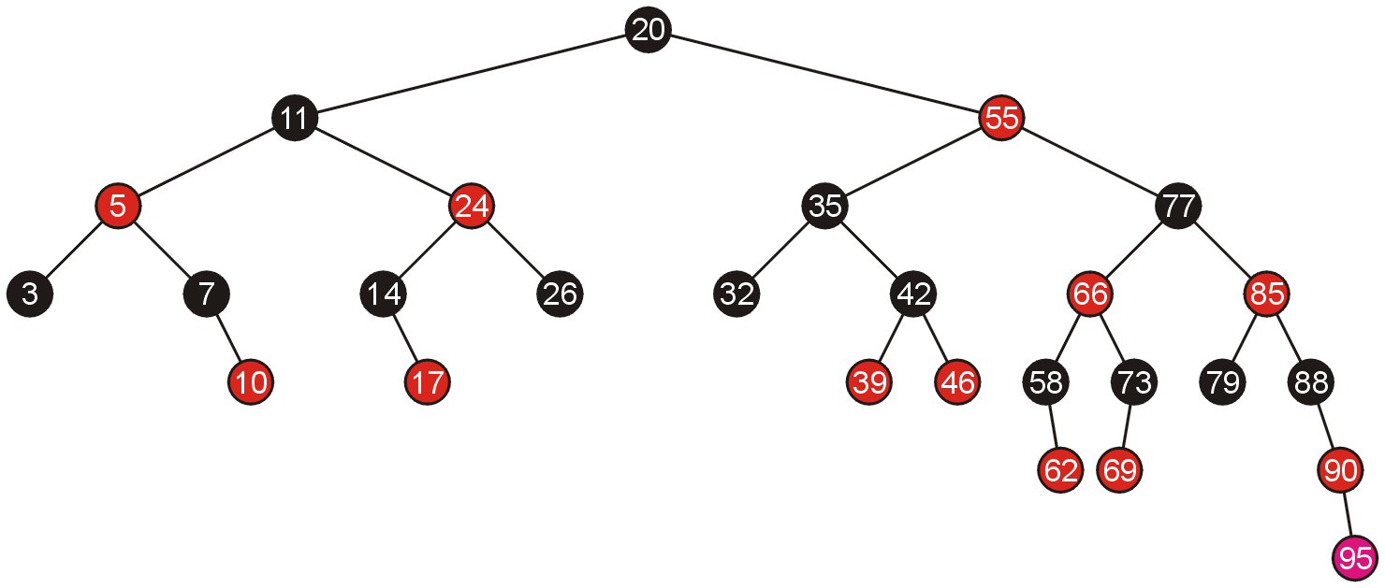
Examples of Insertions
Inserting 95 requires a single rotation

Slide 37
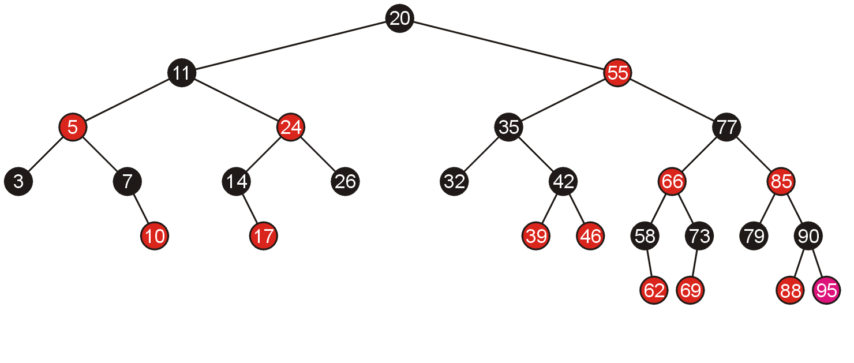
Examples of Insertions
And consequently, we are finished

Slide 38
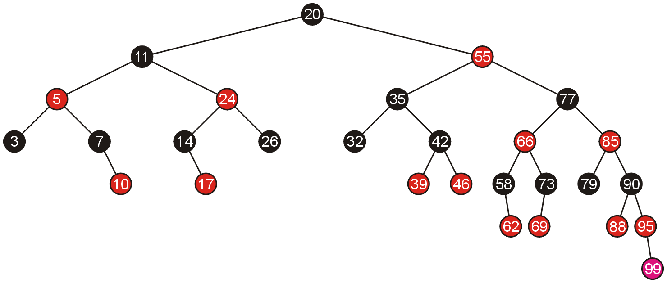
Examples of Insertions
Adding 99 requires us to swap the colours of its grandparent and the grandparent’s children

Slide 39
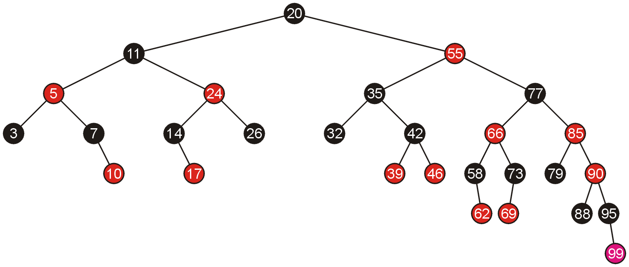
Examples of Insertions
This causes another red-red child-parent conflict between 85 and 90 which must be fixed, again by swapping colours

Slide 40
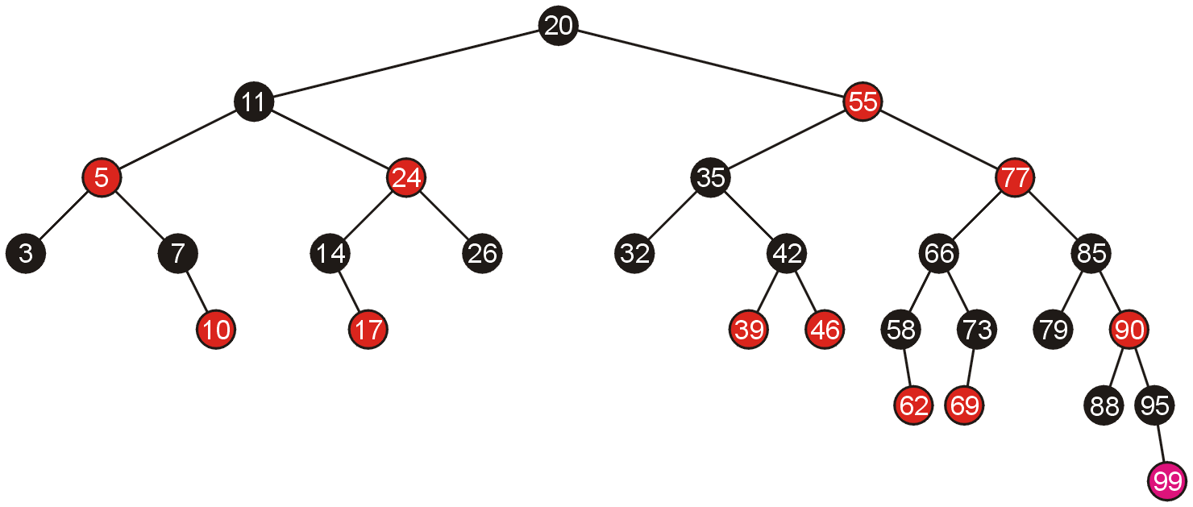
Examples of Insertions
This results in another red-red parent-child conflict, this time, requiring a rotation

Slide 41
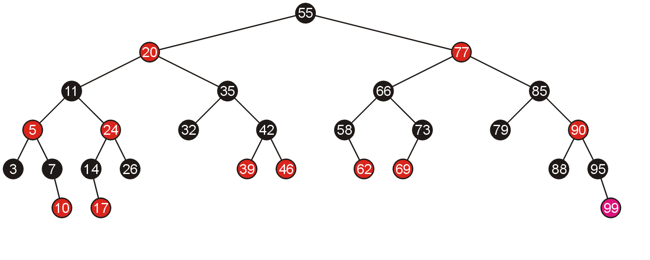
Examples of Insertions
Thus, the rotation solves the problem

Slide 42
Example 2
Create a red-black tree by inserting the following sequence of numbers 8, 18, 5, 15, 17, 25, 40, and 80
Notes:
http://www.btechsmartclass.com/data_structures/red-black-trees.html

Slide 43
Pseudocode
RB-INSERT(T, x) TREE-INSERT(T, x)
color[x] ← RED ⊳ only RB property 3 can be violated
while x ≠ root[T] and color[p[x]] = RED
do if p[x] = left[p[p[x]]
then y ← right[p[p[x]]
if color[y] = RED
then ⟨Case 1⟩
else if x = right[p[x]]
then ⟨Case 2⟩
⊳ y = aunt/uncle of x
⊳ Case 2 falls into Case 3
⟨Case 3⟩
else ⟨“then” clause with “left” and “right” swapped⟩
color[root[T]] ← BLACK
October 19, 2005
Copyright © 2001-5 by Erik D. Demaine and Charles E. Leiserson
L7.24

Slide 44
Graphical notation
Let denote a subtree with a black root.
All ’s have the same black-height.
October 19, 2005
Copyright © 2001-5 by Erik D. Demaine and Charles E. Leiserson
L7.25

Slide 45
Case 1
Recolor
C
C
new x
D
C
C
A
x
y
D
A
B
B
(Or, children of A are swapped.)
Push C’s black onto A and D, and recurse, since C’s parent may be red.
October 19, 2005
Copyright © 2001-5 by Erik D. Demaine and Charles E. Leiserson
L7.26

Slide 46

Case 2
LEFT-ROTATE(A)
C
C_{C}
y
y
A
x
B_{B}
B
x
A_{A}
Transform to Case 3.
October 19, 2005
Copyright © 2001-5 by Erik D. Demaine and Charles E. Leiserson
L7.27

Slide 47
Case 3
RIGHT-ROTATE(C)
y
A_{A}
C
B
B
C
x
A
Done! No more violations of RB property 3 are possible.
October 19, 2005
Copyright © 2001-5 by Erik D. Demaine and Charles E. Leiserson
L7.28

Slide 48
Analysis
Go up the tree performing Case 1, which only recolors nodes.
If Case 2 or Case 3 occurs, perform 1 or 2 rotations, and terminate.
Running time: O(lg n) with O(1) rotations.
RB-DELETE — same asymptotic running time and number of rotations as RB-INSERT.
October 19, 2005
Copyright © 2001-5 by Erik D. Demaine and Charles E. Leiserson
L7.29

Slide 49
Example of Inserting Sorted Numbers
1 2 3 4 5 6 7 8 9 10
Insert 1. A leaf so red. Realize it is root so recolor to black.
1
1

Slide 50
Insert 2
make 2 red. Parent is black so done.
1
2

Slide 51
Insert 3
1
Insert 3. Parent is red. Parent's sibling is black (null) 3 is outside relative to grandparent. Rotate parent and grandparent
2
3
2
1
3

Slide 52
Insert 4
On way down see 2 with 2 red children. Recolor 2 red and children black. Realize 2 is root so color back to black
2
1
3
2
When adding 4 parent is black so done.
1
3
4

Slide 53
Insert 5
2
1
3
4
5's parent is red. Parent's sibling is black (null). 5 is outside relative to grandparent (3) so rotate parent and grandparent then recolor
5

Slide 54
Finish insert of 5
2
1
4
3
5

Slide 55
Insert 6
2
1
4
On way down see 4 with 2 red children. Make 4 red and children black. 4's parent is black so no problem.
3
5

Slide 56
Finishing insert of 6
6's parent is black so done.
2
1
4
3
5
6

Slide 57
Insert 7
2
1
4
3
5
7's parent is red. Parent's sibling is black (null). 7 is outside relative to grandparent (5) so rotate parent and grandparent then recolor
6
7

Slide 58
Finish insert of 7
2
1
4
3
6
5
7

Slide 59
Insert 8
2
1
4
3
6
On way down see 6 with 2 red children. Make 6 red and children black. This creates a problem because 6’s parent, 4, is also red. Must perform rotation.
5
7

Slide 60
Still Inserting 8
2
Recolored now need to rotate
1
4
3
6
5
7

Slide 61
Finish inserting 8
4
Recolored now need to rotate
2
6
1
3
5
7
8

Slide 62
Insert 9
4
2
6
1
3
5
7
8
On way down see 4 has two red children so recolor 4 red and children black. Realize 4 is the root so recolor black
9

Slide 63
Finish Inserting 9
4
2
6
1
3
5
8
7
9
After rotations and recoloring

Slide 64
Insert 10
4
2
6
1
3
5
8
7
9
On way down see 8 has two red children so change 8 to red and children black
10

Slide 65
Insert 11
4
2
6
1
3
5
8
7
9
10
Again a rotation is needed.
11

Slide 66
Finish inserting 11
4
2
6
1
3
5
8
7
10
9
11

Slide 67
Analysis of Insertion
A red-black tree has O(log n) height
Search for insertion location takes O(log n) time because we visit O(log n) nodes
Addition to the node takes O(1) time
Rotation or recoloring takes O(log n) time because we perform
* O(log n) recoloring, each taking O(1) time, and
* at most one rotation taking O(1) time
- Thus, an insertion in a red-black tree takes O(log n) time

Slide 68
Red-Black Trees
In this topic, we have covered red-black trees
simple rules govern how nodes must be distributed based on giving each node a colour of either red or black
insertions and deletions may be performed without recursing back to the root
only one bit is required for the “colour”
this makes them, under some circumstances, more suited than AVL trees

